Slide 1
Intermediate representation

Slide 2
Intermediate Representations
Intermediate Code Representation (IR) is an abstract representation of a program generated by the compiler after the source code is analyzed and before machine code is produced.
It serves as a bridge between the high-level source language and the low-level target machine code.
A compiler typically consists of three major phases:
Front End – Performs lexical, syntax, and semantic analysis.
Middle End – Performs optimization.
Back End – Generates target machine code.
The intermediate representation is produced after semantic analysis and is used as input for optimization and code generation.

Slide 3
Different programming languages can be compiled for different target machines.
Without an intermediate representation, we would need a separate compiler for every source-target combination.
If there are:
  M source languages
  N target machines
Without IR it requires Need M × N compilers
If IR is used it requires M + N components
Thus, IR improves portability and reduces compiler complexity.

Slide 4
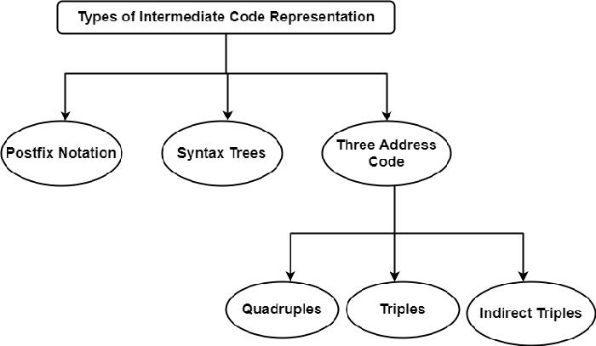
Types of Intermediate Code Representation

Slide 5
Abstract Syntax Tree
An Abstract Syntax Tree, commonly called AST, is an important intermediate representation used in compiler design.
An Abstract Syntax Tree is a tree representation of the syntactic structure of a program in which unnecessary grammar symbols are removed. It preserves only the essential structure of the program.

Slide 6
Parse Tree Vs AST
Parse Tree | Syntax Tree
Parse tree is a graphical representation of the replacement process in a derivation. | Syntax tree is the compact form of a parse tree.
Each interior node represents a grammar rule. Each leaf node represents a terminal. | Each interior node represents an operator. Each leaf node represents an operand.
Parse trees provide every characteristic information from the real syntax. | Syntax trees do not provide every characteristic information from the real syntax.
Parse trees are comparatively less dense than syntax trees. | Syntax trees are comparatively more dense than parse trees.

Slide 7
Considering the following grammar-
E → E + T | T
T → T x F | F
F → ( E ) | id
Generate the following for the string id + id x id
Parse tree
Syntax tree

Slide 8
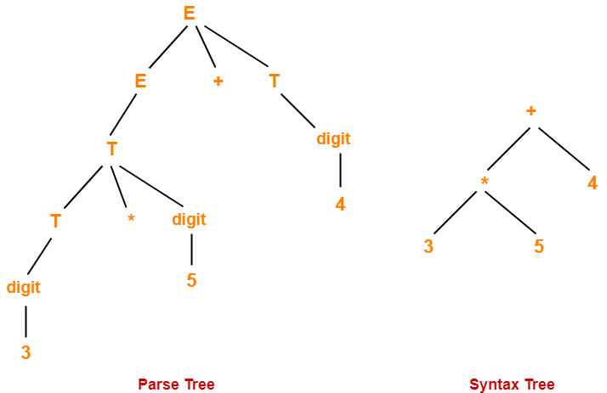

Slide 9
Construct a syntax tree for the following arithmetic expression-
( a + b ) * ( c – d ) + ( ( e / f ) * ( a + b ))
We convert the given arithmetic expression into a postfix expression as-
ab+cd-*ef/ab+*+

Slide 10
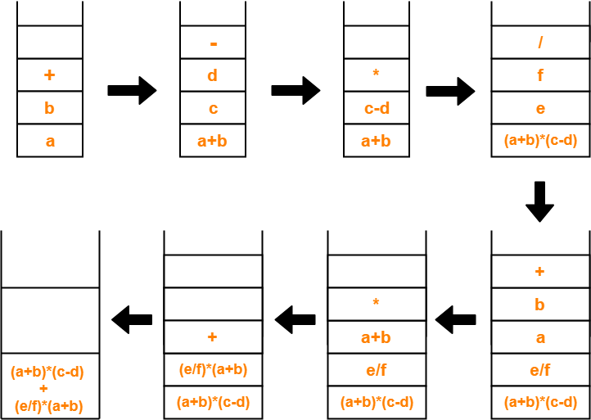

Slide 11
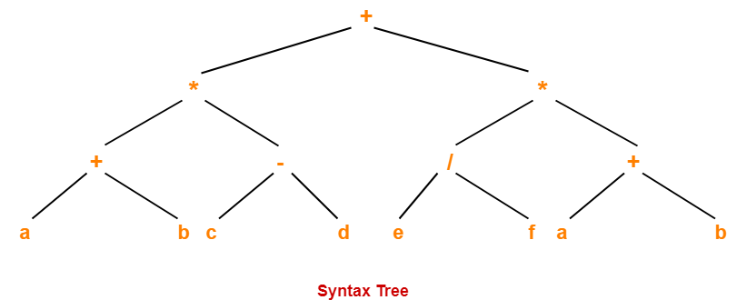

Slide 12
Three Address Code
Three Address Code is an intermediate representation used in compiler design to represent program statements in a simplified form.
It breaks complex expressions into a sequence of simple instructions.
Uses temporary variables (t1, t2, …)
Easy for optimization and code generation

Slide 13
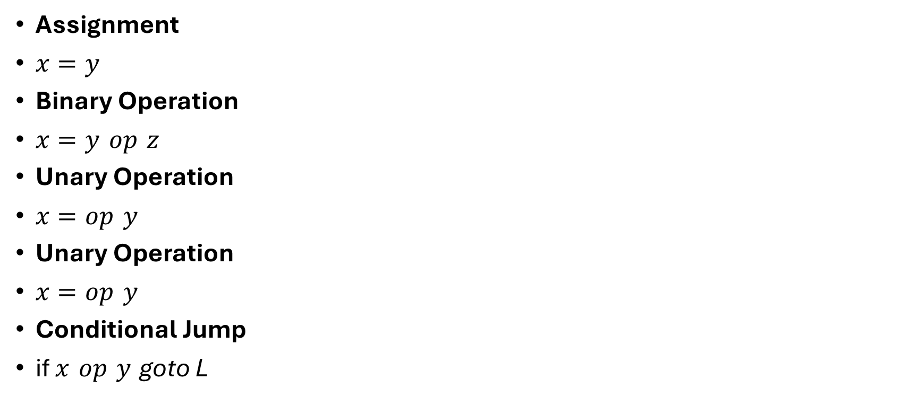
General Forms of TAC Instructions
Assignment
$x=y$
Binary Operation
$x=y op z$
Unary Operation
$x=op y$
Unary Operation
$x=op y$
Conditional Jump
$\text{if} x op y \text{goto} \text{L}$

Slide 14
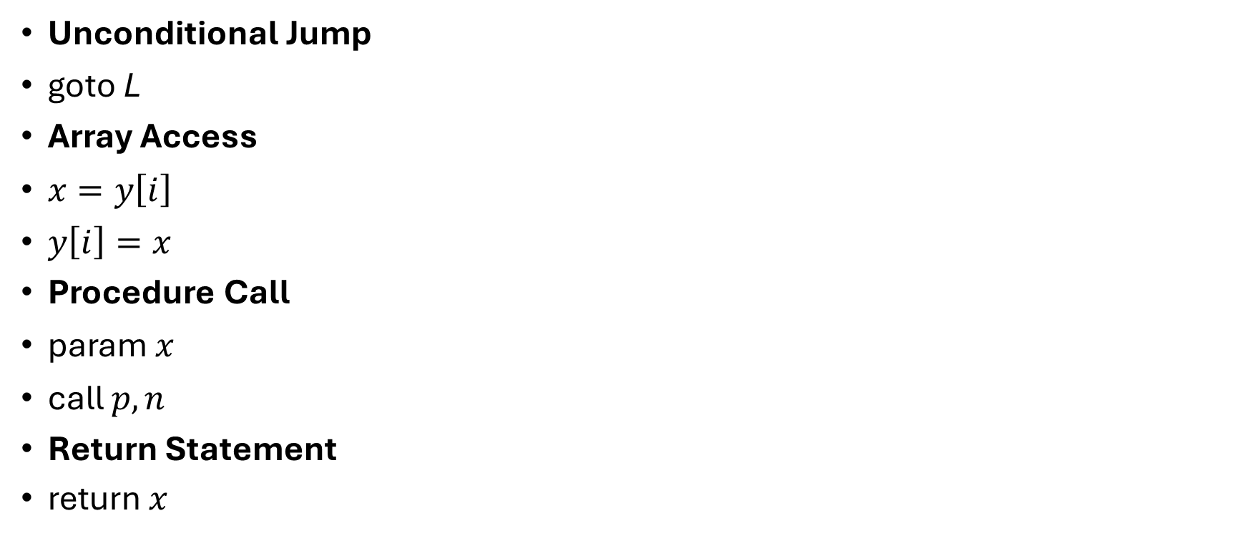
Unconditional Jump
$\text{goto} \text{L}$
Array Access
$x=y\left[i\right]$
$y\left[i\right]=x$
Procedure Call
$\text{param} x$
$\text{call} p,n$
Return Statement
return 𝑥

Slide 15
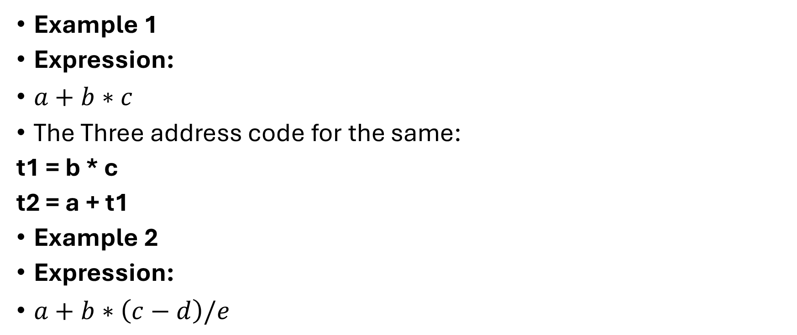
Example 1
Expression:
$a+b∗c$
The Three address code for the same:
t1 = b * c
t2 = a + t1
Example 2
Expression:
$a+b∗\left(c−d\right)/e$

Slide 16
The TAC for the given expression is:
t1 = c - d
t2 = b * t1
t3 = t2 / e
t4 = a + t3
Example 3 (Write TAC for the below expression)
x=−a+b∗c
TAC:

Slide 17
t1 = -a
t2 = b * c
t3 = t1 + t2
x = t3
Example
if (a < b)
x = a + b;
else
x = a - b;

Slide 18
TAC :
if a < b goto L1
t1 = a - b
x = t1
goto L2
L1: t2 = a + b
x = t2
L2:

Slide 19
Generate TAC for the following code:
c = 0
do
{
if (a < b) then
x++;
else
x–;
c++;
} while (c < 5)
TAC for the code:
c = 0
if (a < b) goto (4)
goto (7)
T1 = x + 1
x = T1
goto (9)
T2 = x – 1
x = T2
T3 = c + 1
c = T3
if (c < 5) goto (2)

Slide 20
Generate three address code for the following code-
while (A < C and B > D) do
if A = 1 then C = C + 1
else
while A <= D
do A = A + B
if (A < C) goto (3)
goto (15)
if (B > D) goto (5)
goto (15)
if (A = 1) goto (7)
goto (10)
T1 = c + 1
c = T1
goto (1)
if (A <= D) goto (12)
goto (1)
T2 = A + B
A = T2
goto (10)
15.

Slide 21
Quadruples
A quadruple is a table-based representation of TAC that clearly separates the operation, operands, and result for efficient compilation.
Format of Quadruple
(op, arg1, arg2,result)
Field | Description
op | Operator ( +, -, *, /, etc.)
arg1 | First operand
arg2 | Second operand
result | Where the result is stored

Slide 22
Quadruple Example
a+b∗c
Corresponding TAC:
t1 = b * c
t2 = a + t1
Quadruple Representation:
op | arg1 | arg2 | result
* | b | c | t1
+ | a | t1 | t2

Slide 23
Represent the following code as TAC & Quadruple
while (i < n) {
sum = sum + i;
i = i + 1;
}
TAC:
L1: if i >= n goto L2
t1 = sum + i
sum = t1
i = i + 1
goto L1
L2:

Slide 24
The corresponding Quadruple
No | op | arg1 | arg2 | result
1 | >= | i | n | L2
2 | + | sum | i | t1
3 | = | t1 | — | sum
4 | + | i | 1 | i
5 | goto | — | — | L1
6 | label | — | — | L2

